Slide 1
ENVIRONMENT CONCEPT
Dr. Shakha Sharda
As per PU guidelines.

Slide 2
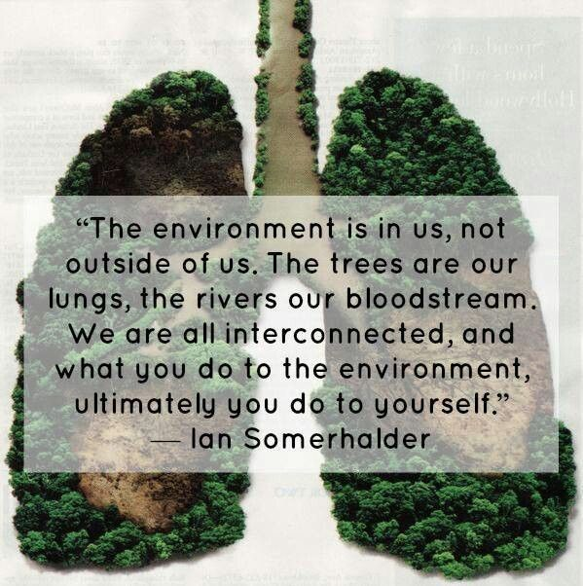

Slide 3
Definition of Environment
derived from French word: en-in and viron-circle means (surroundings).
the sum total of social, economical, biological, physical or chemical factors which constitute the surroundings of a living being.
E.P.Odum: study of structure and function of nature (1971).

Slide 4
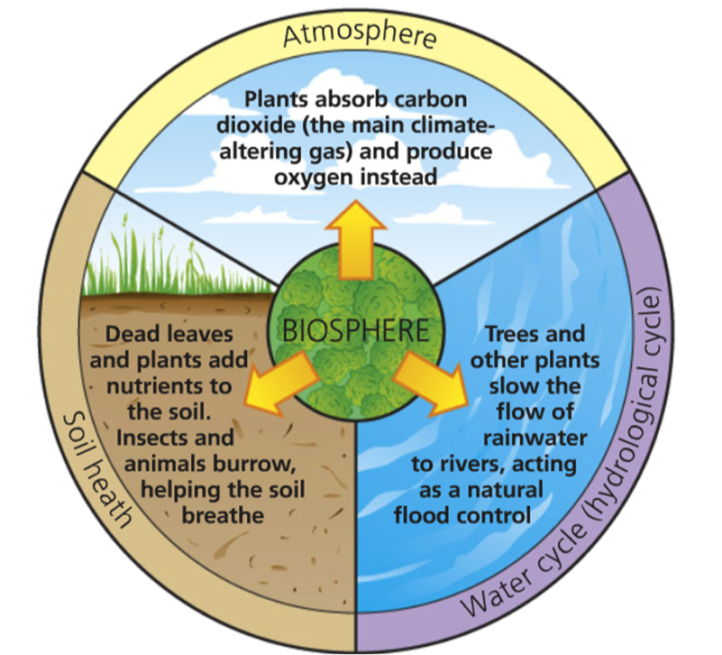
CONCEPT OF BIOSPHERE

Slide 6
Natural Resources
Distribution
national: mineral, land, coal mines etc.
multinational: lakes, rivers, migratory birds
international: air, sunlight etc.
Chemical Nature
Organic: cow dung
Inorganic: minerals
Mixed: Soil

Slide 7
Contd--
Origin
Biotic: forest, wildlife
Abiotic: minerals, fossil fuels
Availability
Inexhaustible: sun, air, water
Exhaustible: petrol, minerals
Renewable Non-Renewable:
e.g. water, soil, biological species e.g. minerals, fossil
fuels

Slide 8
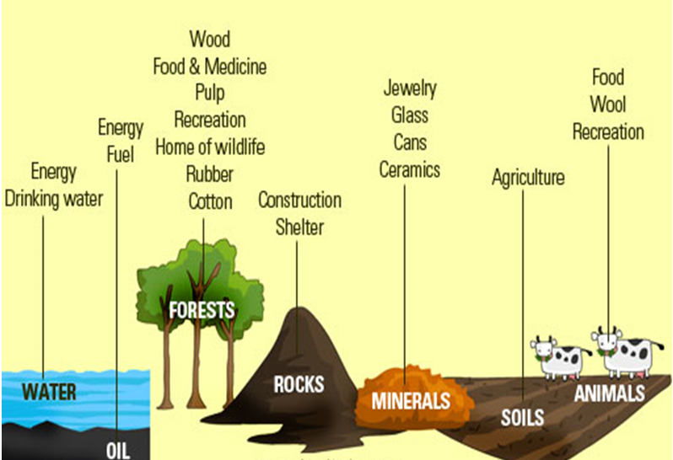
USES OF NATURAL RESOURCES

Slide 9
Ecology
Derived from Greek word oikos means home
Term coined by Earnest Haeckel in 1866
Principles of Ecology
Scope of Ecology
proceeds at three level
individual
population
community

Slide 11
Ecosystem
Coined by A.G. Tansley in 1935.
Self-sustainable or self-sufficient
Components of Ecosystem
Biotic
autotrophs e.g. plants
heterotrophs e.g. consumers
saprotrophs e.g. decomposers
Abiotic
physical
chemical
inorganic

Slide 12
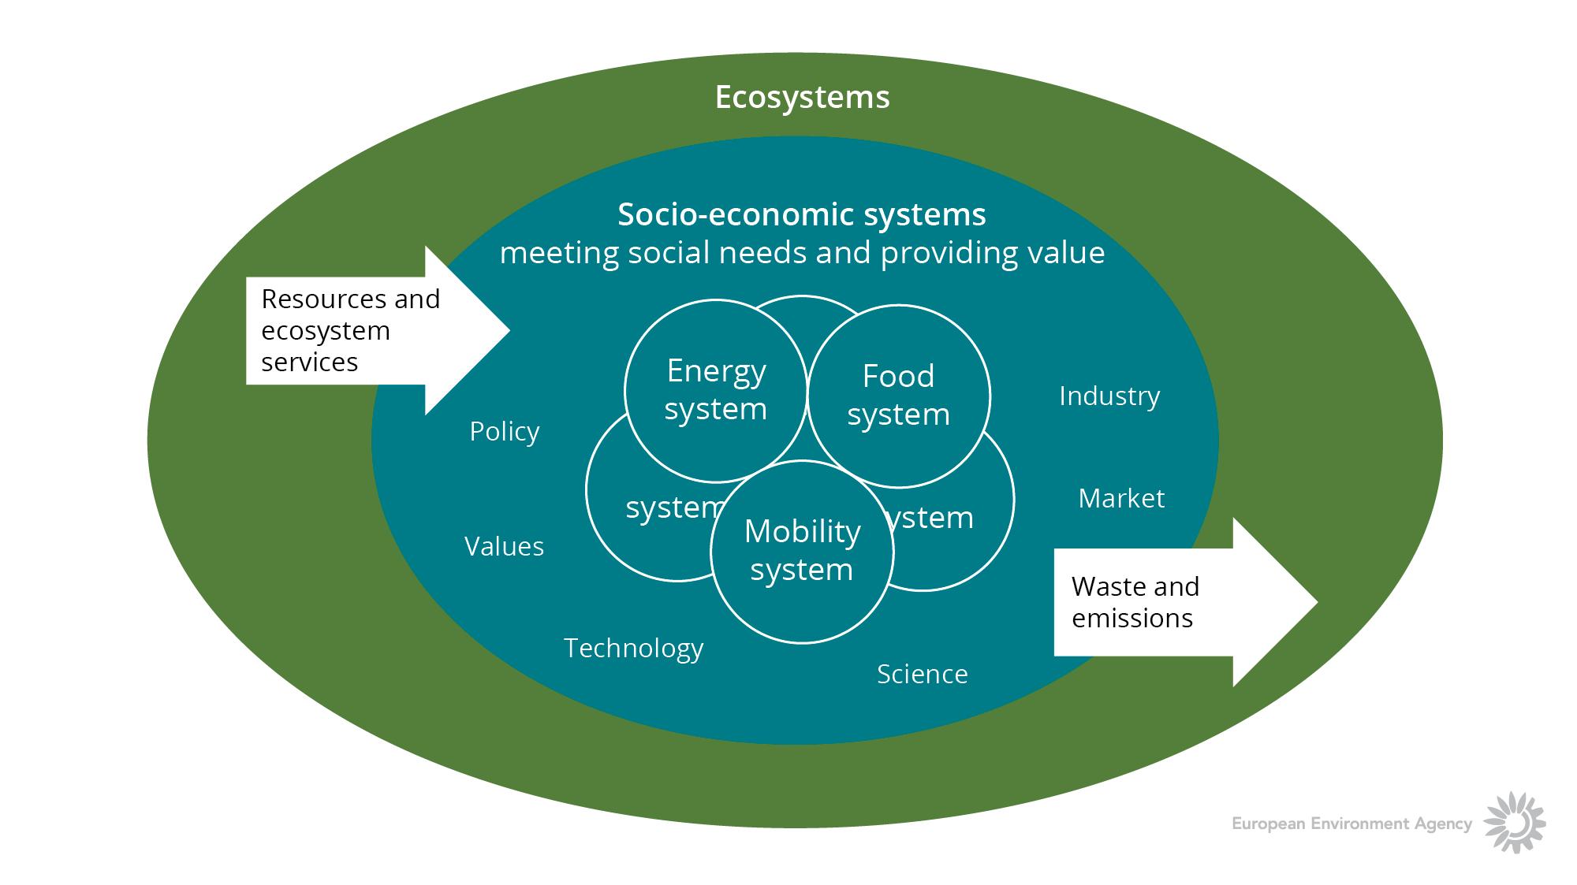

Slide 13
Ecosystem Structure
Food chains
Trophic levels
Food webs
Ecological pyramids (Charles Elton)
number : upright, inverted and spindle
biomass: upright, inverted
energy: always upright

Slide 14
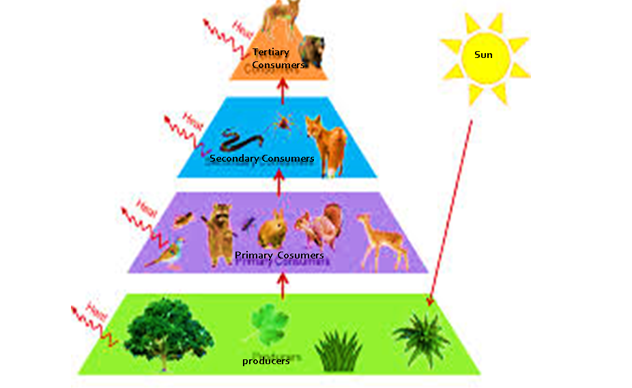
TROPHIC LEVELS

Slide 15
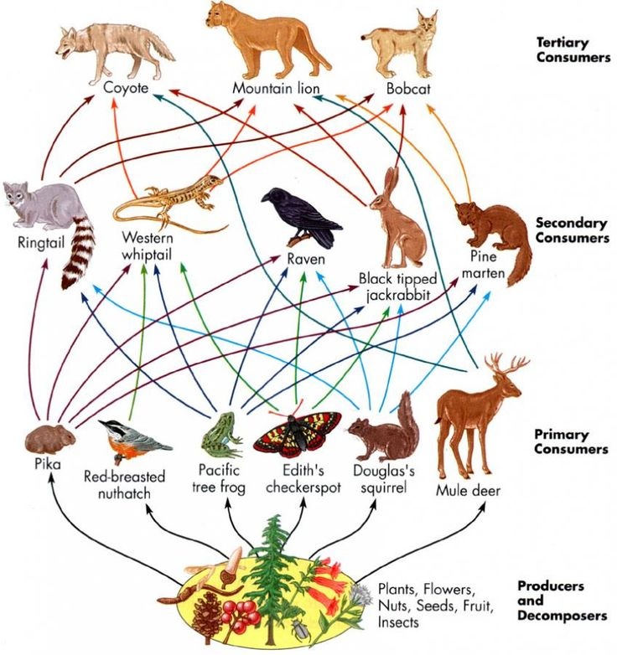
FOOD WEB

Slide 16
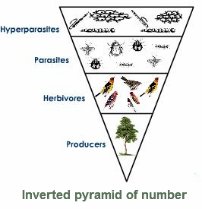
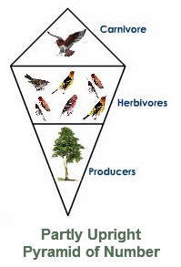
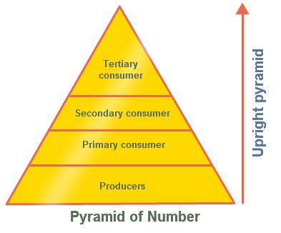
Parasitic food chain
Forest ecosystem
Aquatic and grassland ecosystem

Slide 17
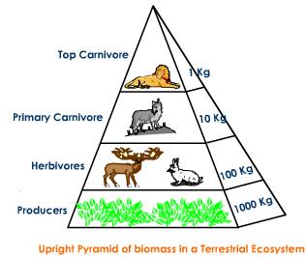
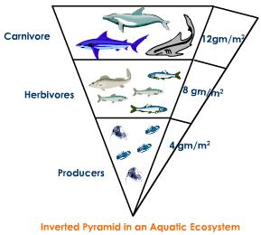

Slide 18
Ecological Succession
Hydrosere water
Xerosere bare land
Lithosere rocks
Psammosere sand
Halosere saline soil

Slide 19
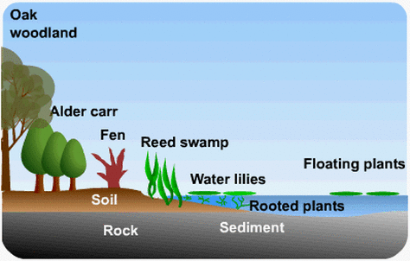
HYDROSERE: POND ECOSYSTEM

Slide 20
Biotic Interactions
Competition - -
Parasitism - +
Predation + -
Commensalism 0 +
Ammensalism - 0
Protocooperation/ Mutualism + +
Symbiotic + + (obligatory)

